Slide 1
Team 3 - 1.4; Topic 1: Enhancing the Song Recommender Engine from Module 11.4.
Ally Dong, Hannah Moreau, Varun Sivakumar, Sahieshnu Vasanthan.

Slide 2
Table of contents
01
02
03
04
05
Data Exploration.
Clustering Algorithms.
The Model & Enhancements.
Created by Hannah.
Created by Ally.
Created by Sahieshnu & Ally.
User Feedback.
Future Enhancements.
Created by Varun.
Created by Varun.

Slide 3

01
The Model & Enhancements.

Slide 4
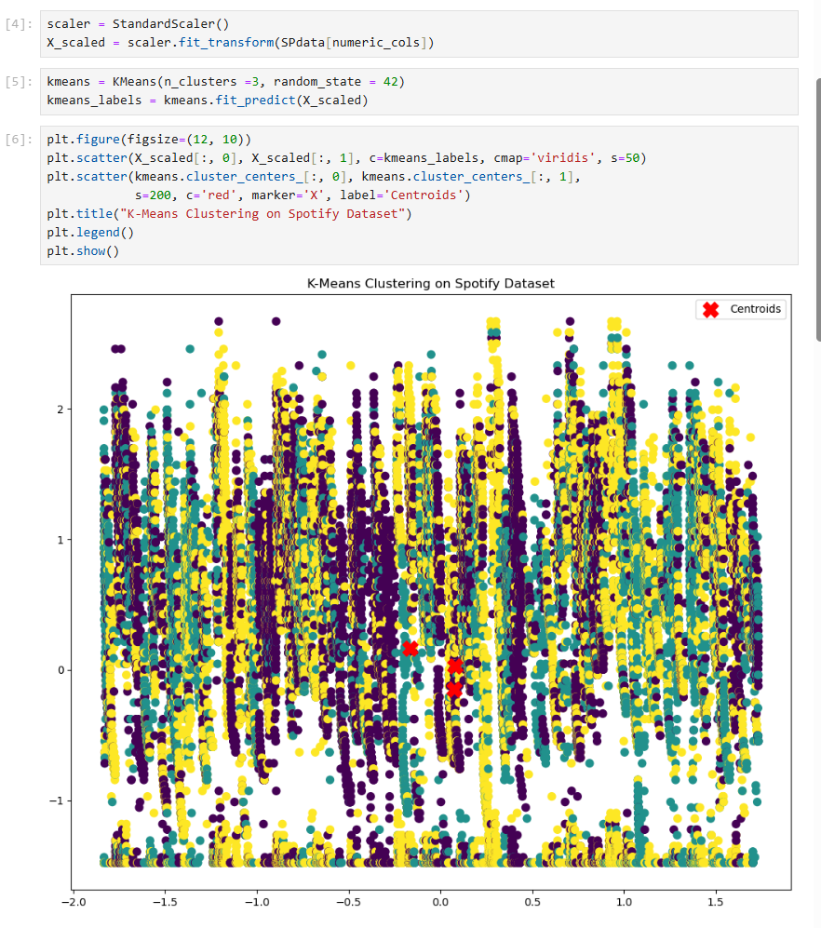
The Model.
The model on the right shows the original K-Means model, and the plot.

Slide 5
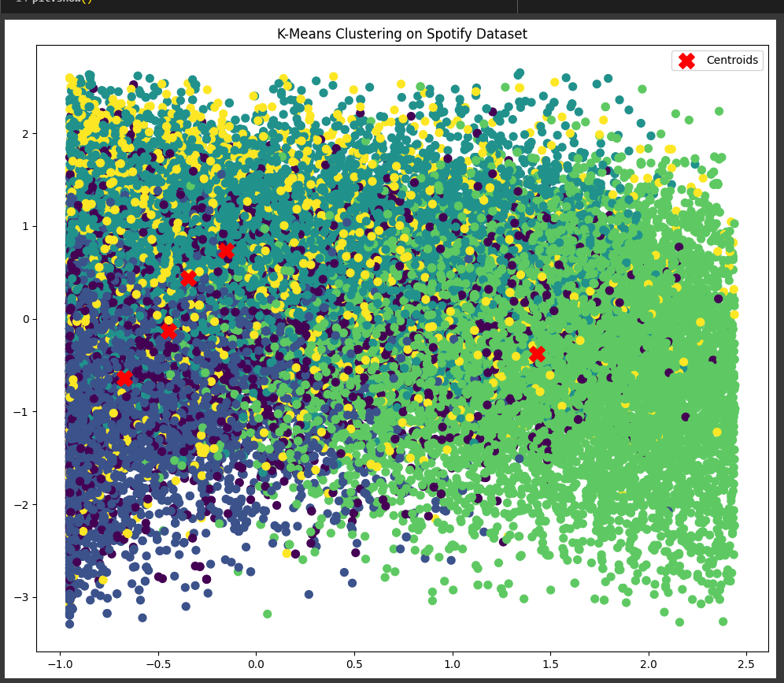
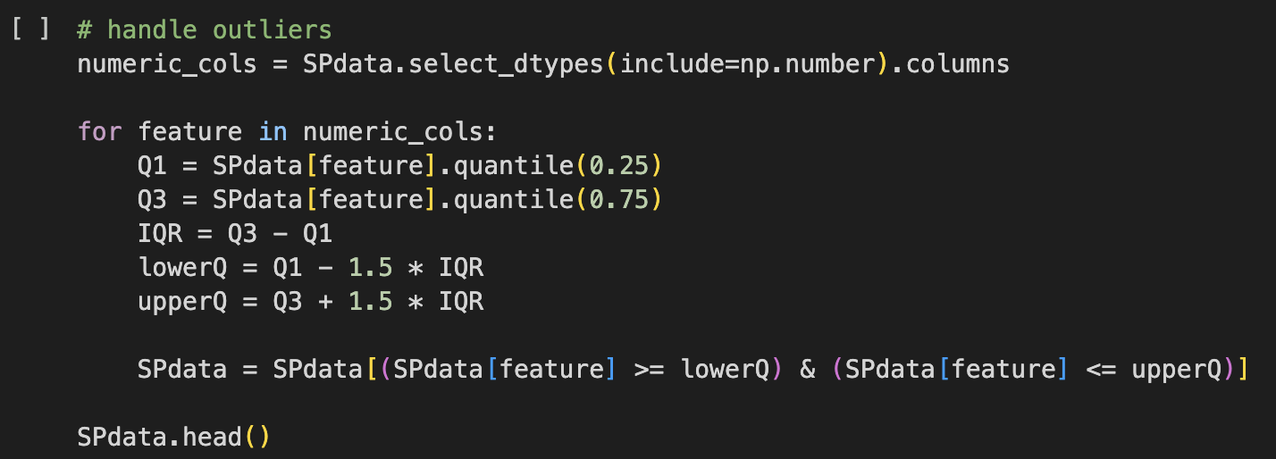
Enhancements & their Benefits
This is the enhanced model.

Slide 6
02
Data Exploration.

Slide 7
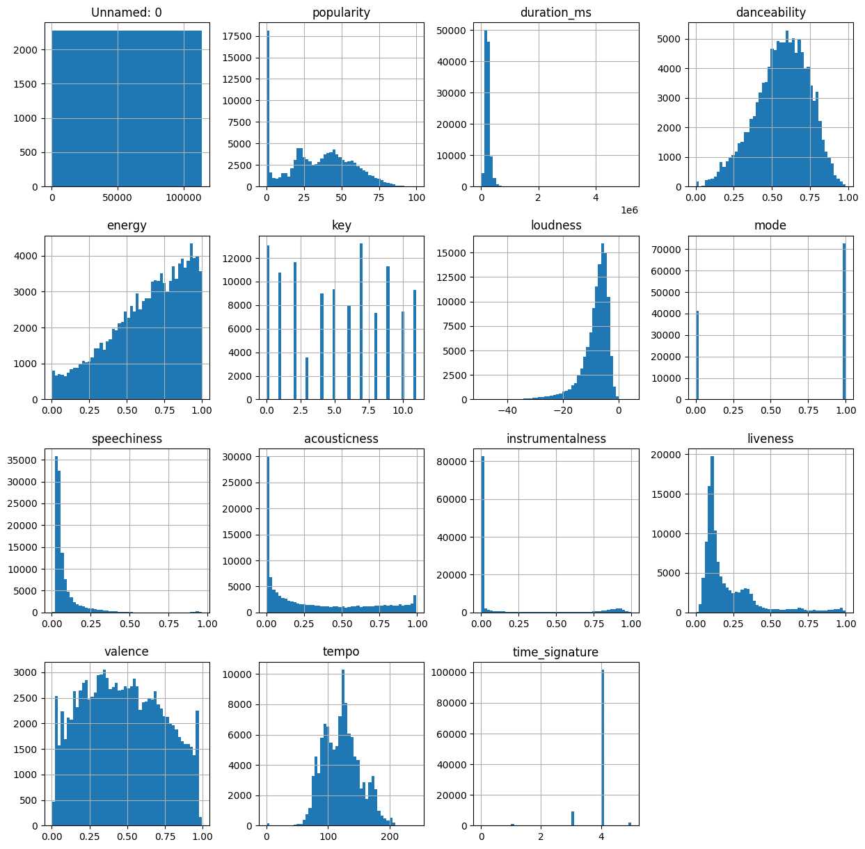
Histograms
Takeaways
- Most songs had a danceability of upper middle range
-Most songs were higher in energy
-Most songs had a medium tempo
Notes:
Hannah

Slide 8
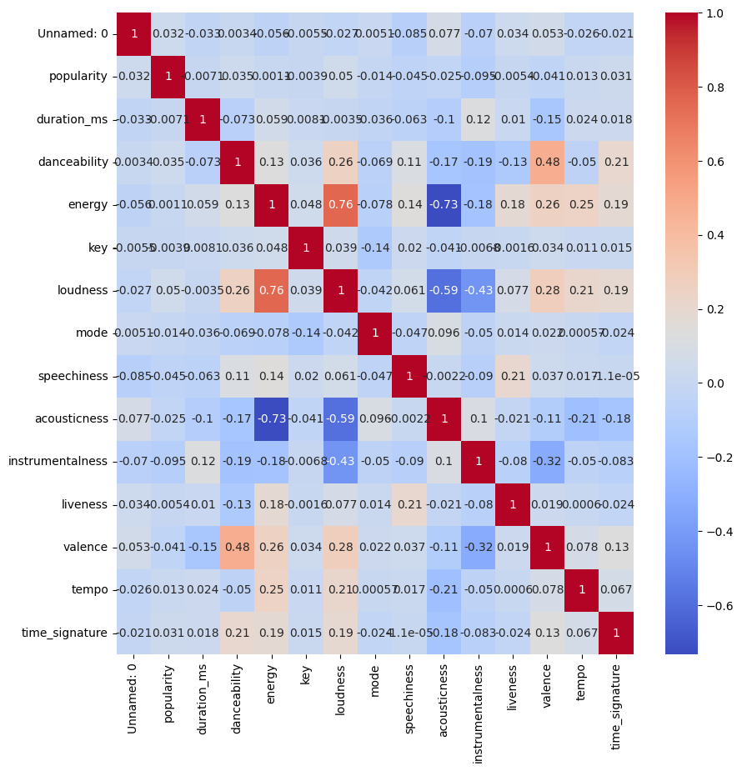
Heat Map and Correlation
Takeaways
Most variables are not correlated or very lowly correlated. Loudness and energy are positively correlated, and energy and acoustic ness are negatively correlated. Using the genre of a song could also provide information.
Notes:
Hannah

Slide 9
03
Clustering Algorithms.

Slide 10
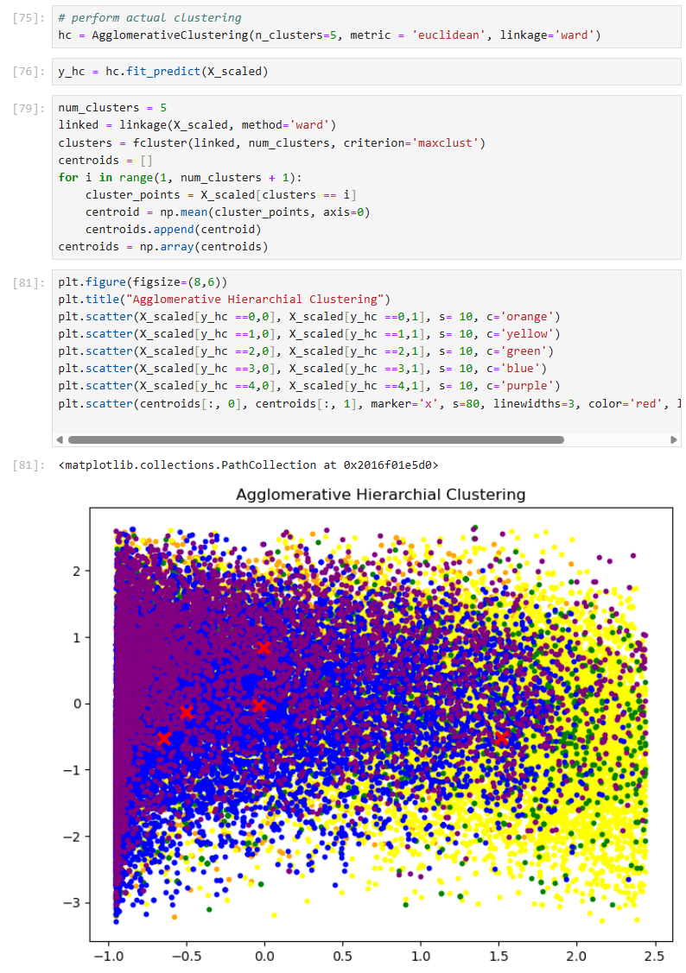
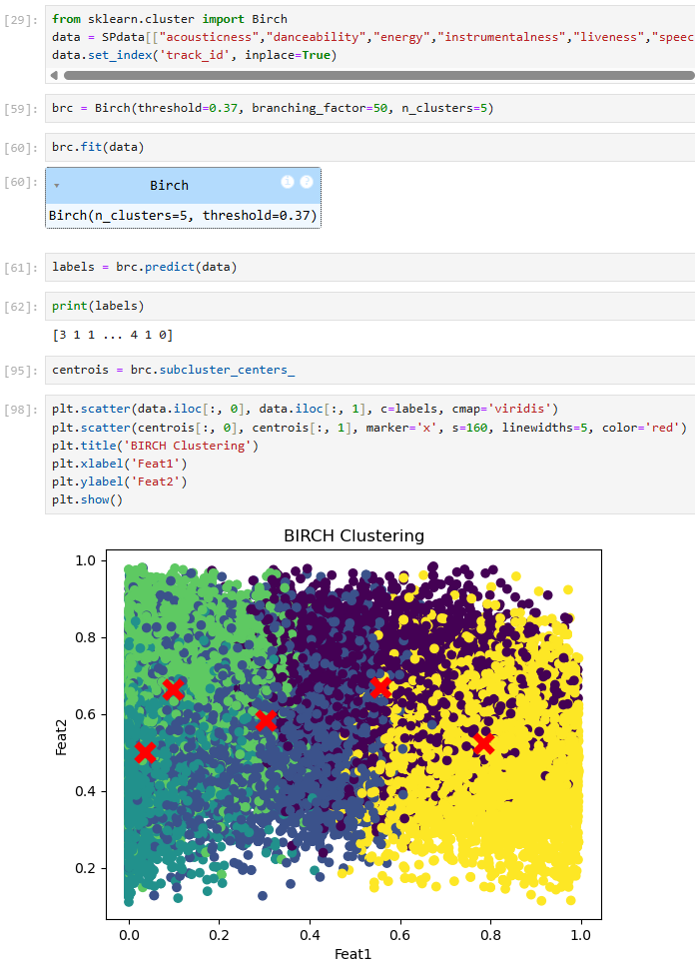
Compare & Contrast.
Agglomerative Hierarchical:
The agglomerative hierarchical clustering algorithm shows five clusters that are stacked on top of one another, and centroids indicating the average distance to the midpoint from all data points. There is clearly a noticeable amount of overlap which tells us that the data points belong to multiple clusters and can direct us towards more flexible clustering algorithms to get better results. This plot derives from considering each data point as a cluster and continuously merging into nearby clusters until the optimal cluster amount is reached.
BIRCH:
The BIRCH clustering algorithm shows five clusters that overlap surrounding clusters, and centroids indicating the center of the subcluster of data points. This tells us that there is distinction between the data points (the songs) yet some similarity due to the overlap where the data points fit between more than one cluster. This plot is created from the CF-tree (Clustering Feature tree) that organizes the data points which is part of the BIRCH process.
Notes:
Ally Dong

Slide 11
Advantages & Trait Comparison.
K Means | Agglomerative | DBSCAN | BIRCH
Centroid-based Within-cluster sum of squares Sensitive to outliers | Merging process Requires linkage criteria Computationally expensive Allows use of distance metrics | Auto-determines number of clusters Non-linear complex clustering Flexible towards outliers & noise | Can handle large datasets Uses CF-tree for memory efficiency Flexible towards outliers & noise
All of the above work with unlabeled data.
Notes:
Ally Dong

Slide 12
04
User Feedback and Future Enhancements

Slide 13
How user feedback can be incorporated into the model in future and its impact
Collect user ratings after song recommendations (e.g., Like / Dislike or 1–5 stars).
Store feedback in a log with song features and cluster info.
Use feedback to: Refine clustering over time (weighted relevance). Personalize future suggestions.
Could explore reinforcement learning to adapt to user preferences dynamically.
Result: A more accurate, personal, and responsive recommendation engine.
Notes:
Right now, our recommender engine clusters songs based on things like energy, and valence — which works pretty well. But to take it to the next level, we need to bring the user into the loop.
Imagine after a set of recommendations, we simply ask users to rate the songs — like a thumbs up or a thumbs down. Those ratings could then be stored along with the song's audio features and the cluster it came from.
Over time, the model could learn patterns, like which types of songs certain users enjoy most. And as we collect more feedback, we could use that data to adjust clusters or even personalize recommendations per user.
Eventually, we could even explore more advanced stuff like reinforcement learning — where the model actively updates itself based on user responses.
Basically, user feedback helps the system grow smarter and more personal — making each round of recommendations better than the last.

Slide 14
Future Enhancements that can be made to the model
📍 Genre-Based Filtering: Add genre awareness for more diverse or refined clusters.
🌍 User Profile Integration: Let users create profiles to track preferences.
🤖 Hybrid Models: Combine content-based filtering with collaborative filtering (like Spotify’s real engine).
📊 More Audio Features: Use additional Spotify features like key, mode, time signature for deeper clustering.
🎯 Real-Time Recommendation Tuning based on current mood/activity.
Notes:
So besides adding feedback, there are a bunch of other ways we could improve the model.
First, we could factor in genres. Right now, we’re clustering based on numeric features, but songs from totally different genres might still end up in the same cluster. Adding genre could help keep recommendations more relevant.
We could also give users simple profiles that save their favorite songs, so the model gets smarter over time about what they actually like. Maybe even adjust suggestions based on mood or activity — like workout vs. chill. Another idea is combining what we have now with collaborative filtering — like how Spotify recommends what people similar to you are listening to. That hybrid approach would make the engine way more powerful.
And finally, there are other Spotify features we could include, like musical key or mode, which might help the clusters get even more accurate.
All these tweaks could help make the model feel more like a real-world music recommender — personalized, flexible, and way more fun to use.

Slide 15
EXIT TICKET.
If you had to pick one, which future enhancement do you think would benefit users the best?
Notes:
Ally Dong

Slide 16
Thanks!
Any questions?
Team 3:
ally_dong@brown.edu
hannah_moreau@brown.edu
varun_sivakumar@brown.edu
sahieshnu_vasanthan@brown.edu

Slide 17


